Slide 1

CROP YIELD PREDICTION
- Machine Learning
PRESENTATION BY ZALAK PATEL

Slide 2

OBJECTIVE:
IMPORTANCE:
The purpose of this project is to apply machine learning algorithms on Crop Yield Prediction to predict crop yield which can be beneficial to farmers to enhance agriculture and have increment in growth of crops using yield prediction.
Importance of Crop Yield Prediction can be seen in the field of agriculture which decreases the risks for loss to farmers and use resources and their energy wisely. This models can give accurate prediction to farmers which helps them to grow crops accordingly which benefits them from wastage of resources and money. This prediction encourages profitable agriculture and helps to grow according ratio of railfall, pesticides, temperature etc which helps in beneficial farming. This can be said as a small step towards smart farming techniques which can be effective globally for good farming.

Slide 3

In this Dataset of Crop Yield Prediction:
Temperature and Rainfall data is collected from World Bank Data. In temp dataset there are 71312 rows and 3 columns and in rainfall dataset there are 6728 rows and 3 columns. Pesticides and Yield are collected from Food and Agriculture Organization in which pesticides dataset include 4350 rows and 7 columns where as yield includes 56718 rows and 12 columns.
Further, after cleaning and merging this data yield_df is created using necessary columns and rows from temperature, pesticides, rainfall, yield and final dataset is created. There are 28243 rows and 8 columns in Yield_df which is used for our project. Column names in yield_df include Area, item, year, hg/ha_yield, average_rainfall_mm_per_year, pesticides_tonnes, avg_temp.
Area: this column indicates country.
Item: it indicates the name of crops.
Year: it presents year in which crop was sown.
Hg/ha_yield: this field indicates yield hectogram per hectare.
Rainfall_mm_per_year: It indicates amount of rainfall in mm per year
Pesticides_tonnes: shows the amount of pesticides used in crop per year.
Avg_temp: indicates the average temperature of the area.
DATASET DESCRIPTION:
SOURCE OF DATASET:
https://www.kaggle.com/datasets/patelris/crop-yield-prediction-dataset

Slide 4
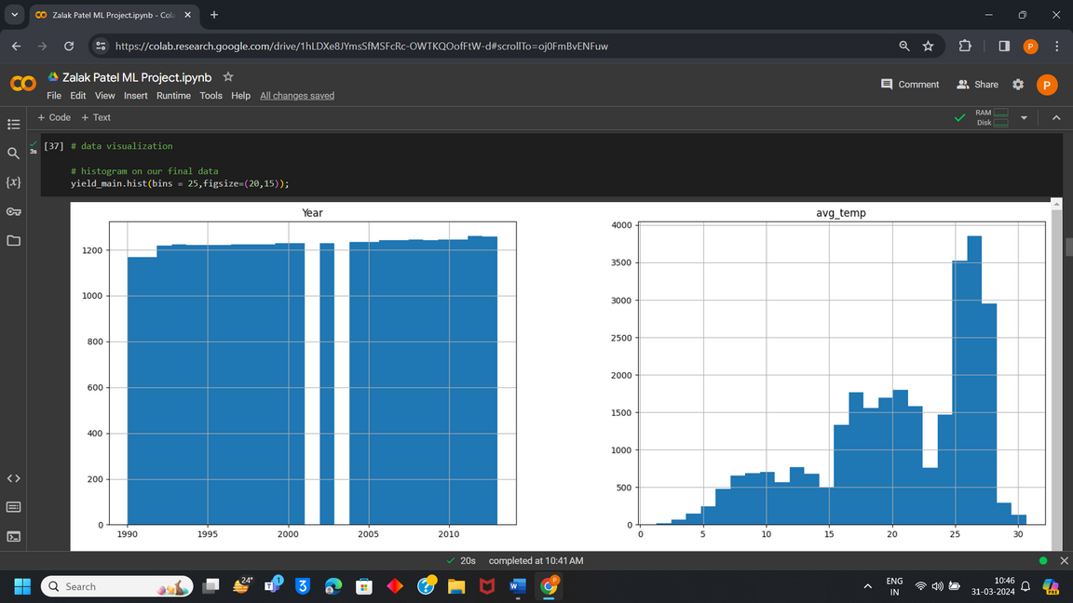
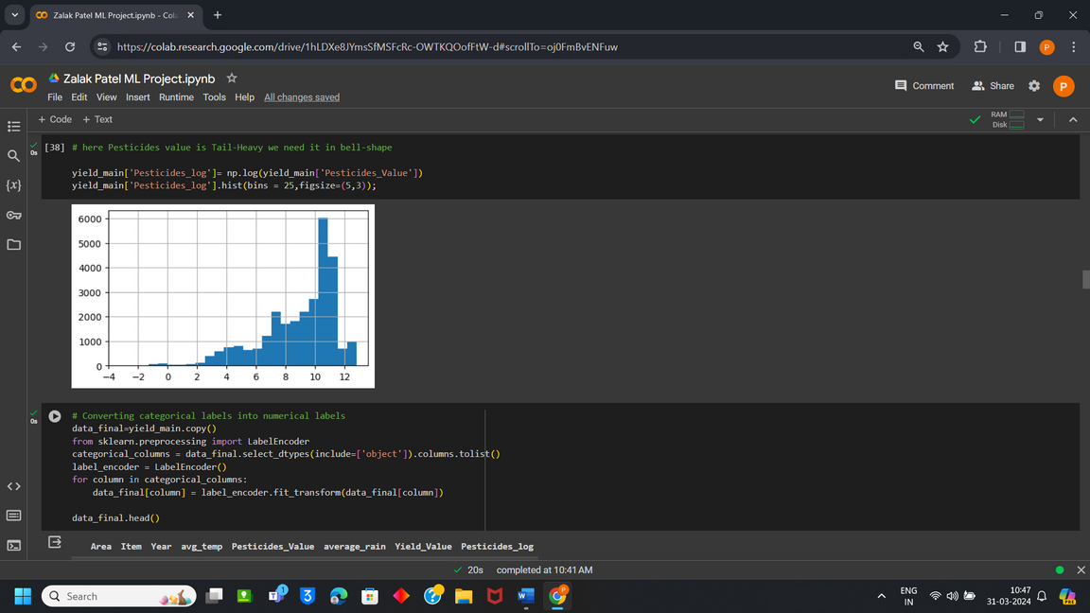
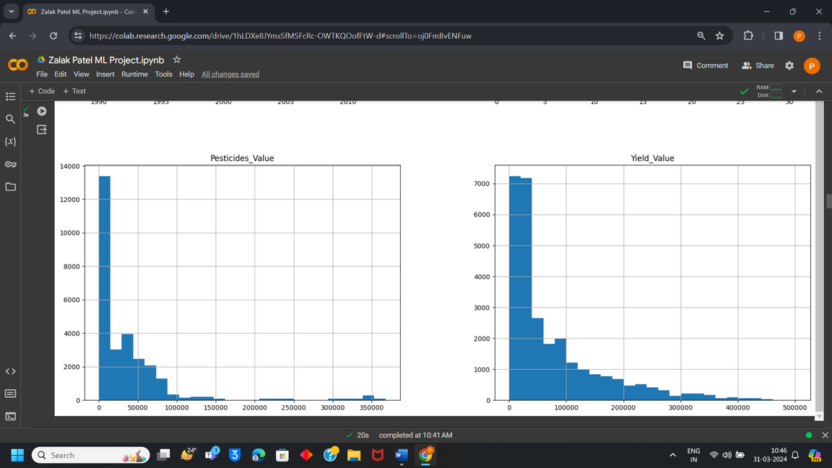
DATA VISUALIZATION

Slide 5
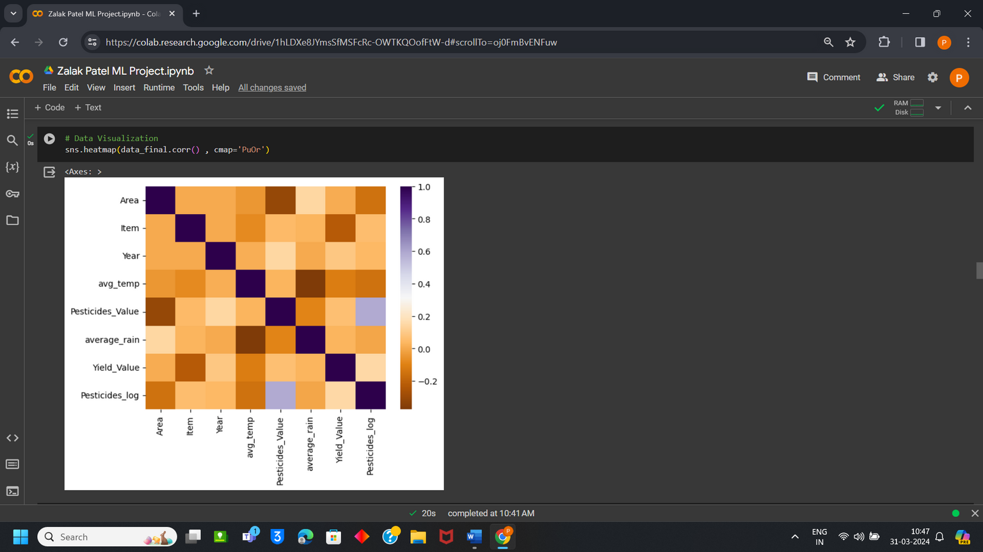
DATA VISUALIZATION

Slide 6
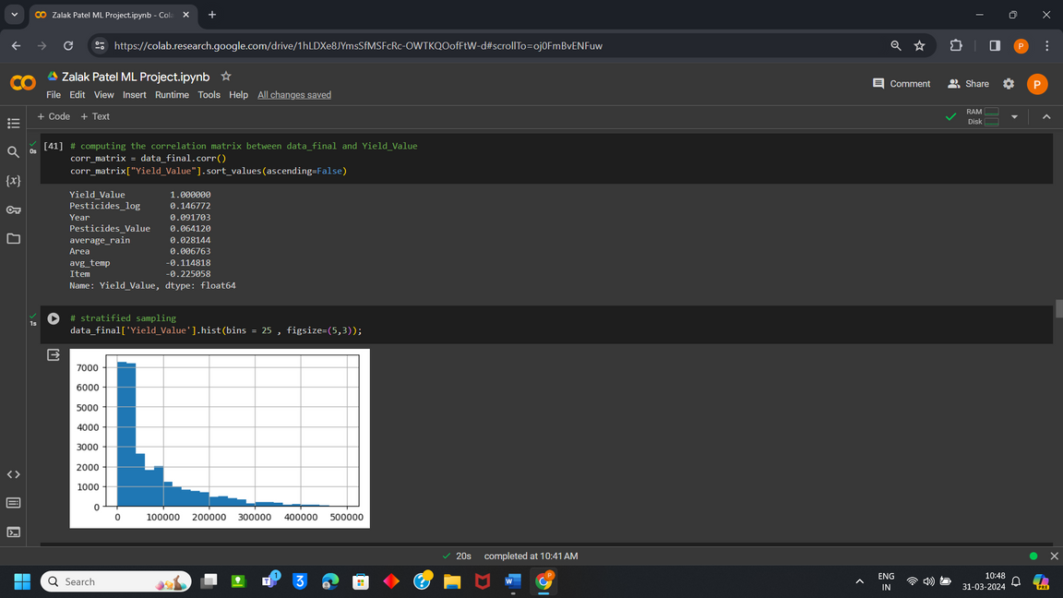
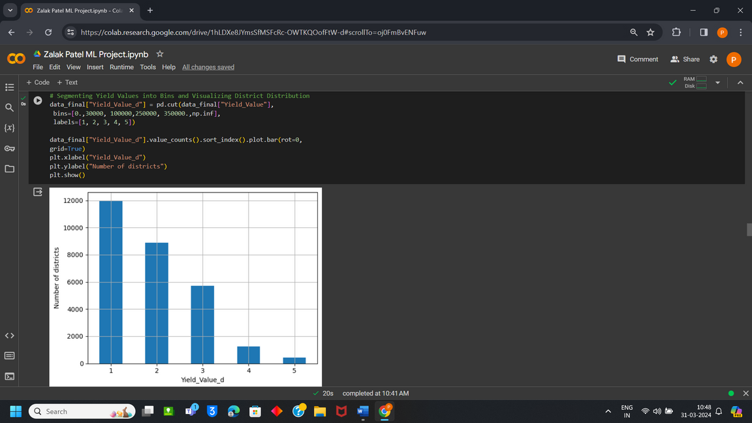
STRATIFIED
SAMPLING

Slide 7


LINEAR REGRESSION
Algorithm Technique
Case Study Application
Linear Regression Algorithm is used to identify linear Relationship between independent variables and dependent variables. Value which is to be predicted is known as dependent variable and value which is used to predict the outcome is known as Independent Variable. Value of one Variable can be predicted depending upon value of another variable.
Here according to my project dependant variable is yield and pesticides, rainfall, temperature etc are known to be independent variable. Based on this factors of independent variable crop yield is predicted for instance if high temperature and balanced amount of pesticides are observed then it can result in increment in crop yields.

Slide 8
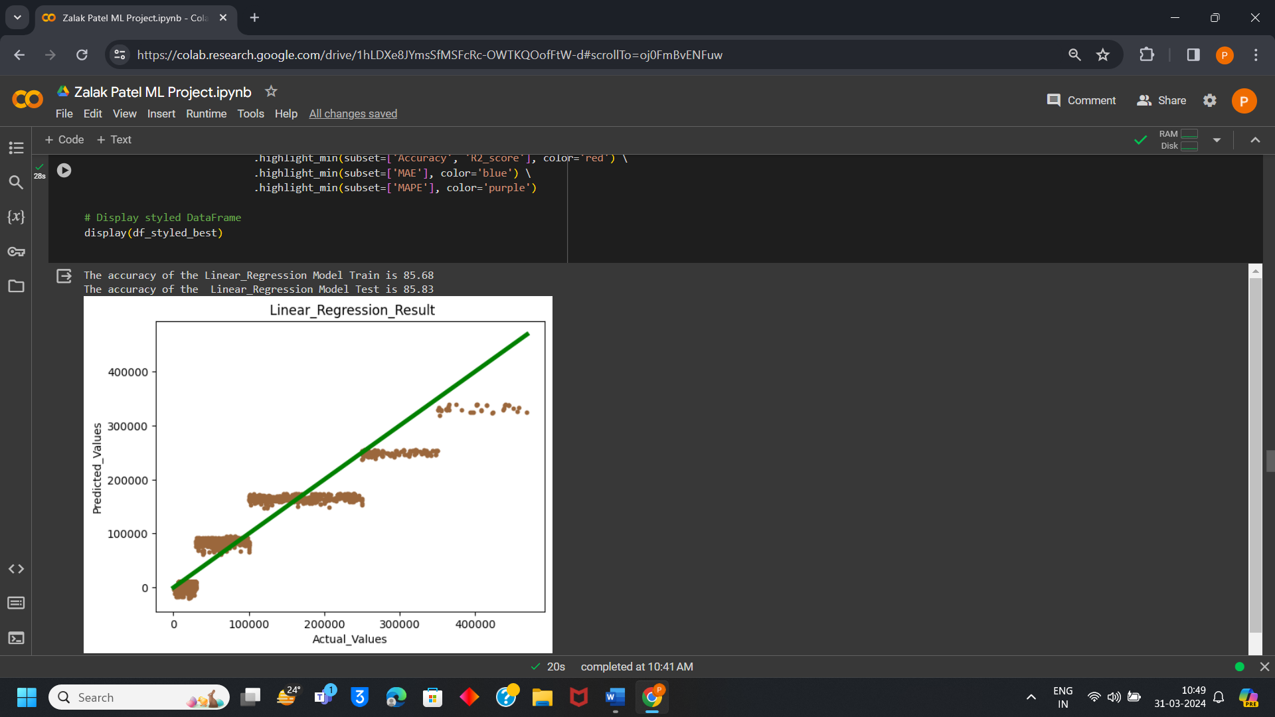

LINEAR REGRESSION
HYPERPARAMETER TUNING

Slide 9
RANDOM FOREST
Algorithm Technique
Case Study Application
Crop production may be predicted using a random forest model by taking into account variables like soil pH, humidity, temperature, rainfall, and crop type. In order to provide reliable predictions, each decision tree in a forest takes into account a random selection of characteristics and data points. Compared with individual decision trees, random forests are not as prone to overfitting and can accommodate a high number of input characteristics. It is skilled at handling non-linear characteristics and correlations and can identify complex relationships among characteristics and yields of crops.
Random forest is known for both classification and regression problems as it can handle both fluently in most of the cases. Combining the outcome of multiple decision trees Random Forest reaches to a single result. It is easy and flexible to use.

Slide 10
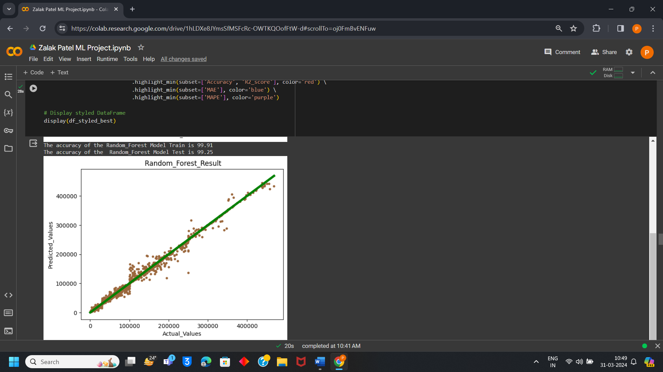
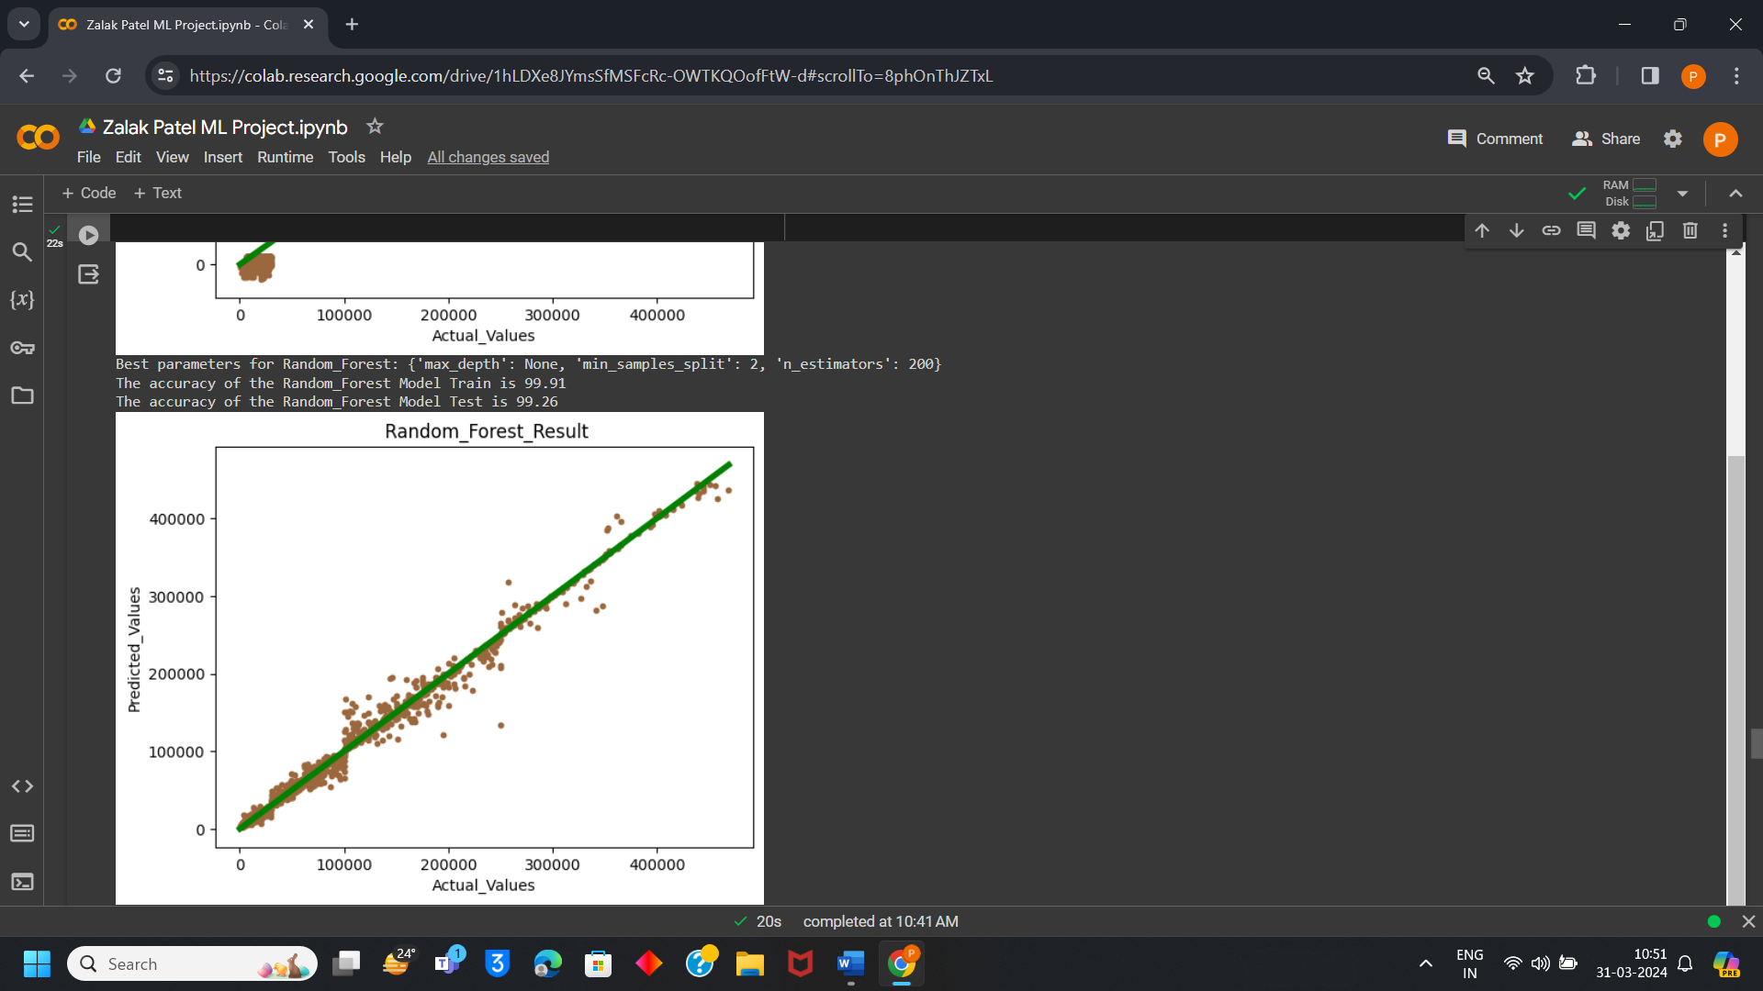
RANDOM FOREST
HYPERPARAMETER TUNING

Slide 11
K-NEAREST NEIGHBOUR
Algorithm Technique
Case Study Application
neighbours (KNN) is a simple approach that works well for classification and regression applications. A random, supervised learning classifier, the k-nearest-neighbours (KNN) technique use similarity to classify or predict how a single data point will be grouped.
KNN uses historical data to identify the K closest nearby fields for a particular set of environmental parameters, such as rainfall, temperature, and soil nutrients. The crop production of the present field is then predicted using the average yield from these nearby fields.

Slide 12
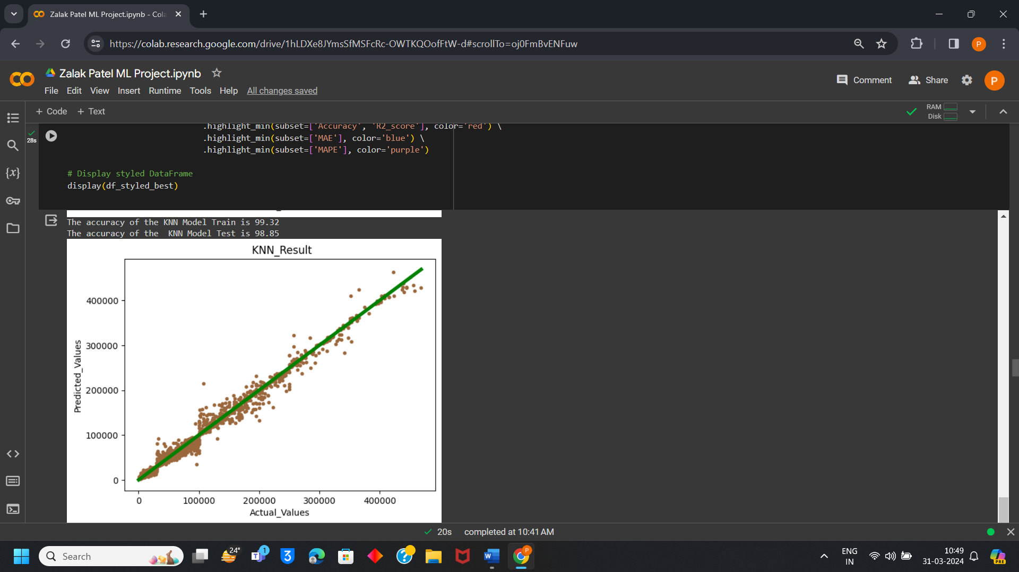

k-NEAREST-NEIGHBOUR
HYPERPARAMETER TUNING

Slide 13
DECISION TREE
Algorithm Technique
Case Study Application
Recursively dividing the feature space according to the most informative characteristics, decision trees are simple models. They can handle both category and numerical data, and they are simple to comprehend. A not parametric supervised learning approach that is used for both regression and classification applications is the decision tree. With the root node, branches, internal nodes, and leaf nodes, it has a hierarchical tree structure.
To estimate agricultural yield, a decision tree may first divide the data according to the most important characteristic (temperature, for example). Every split after that improves the forecast even further by taking into account other elements like soil nutrients and rainfall. The nodes of the leaves in a tree, where every leaf represents a unique combination of feature values, are where the ultimate predictions are produced.

Slide 14
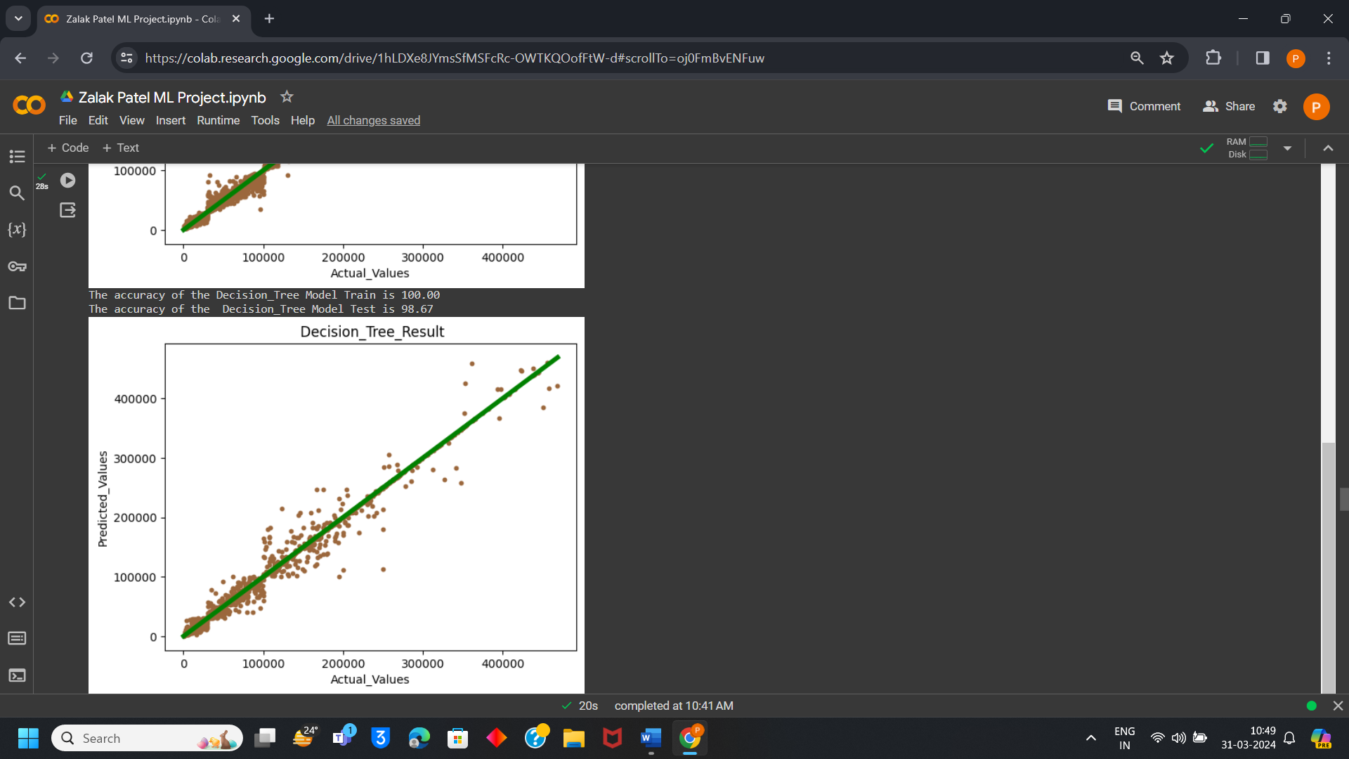
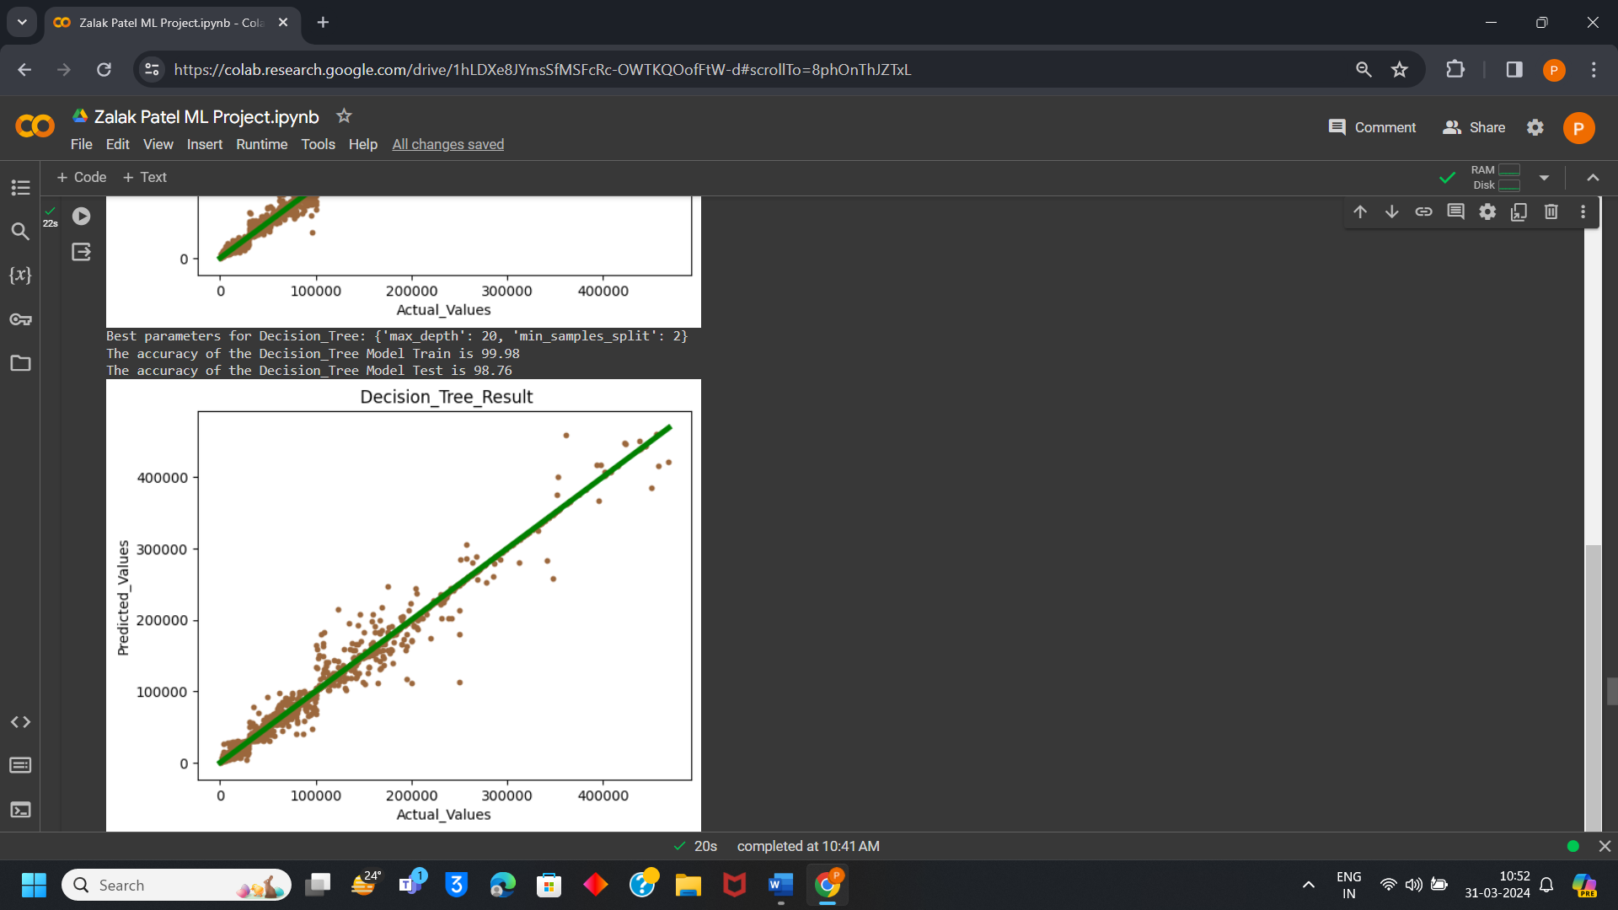
DECISION TREE
HYPERPARAMETER TUNING

Slide 15
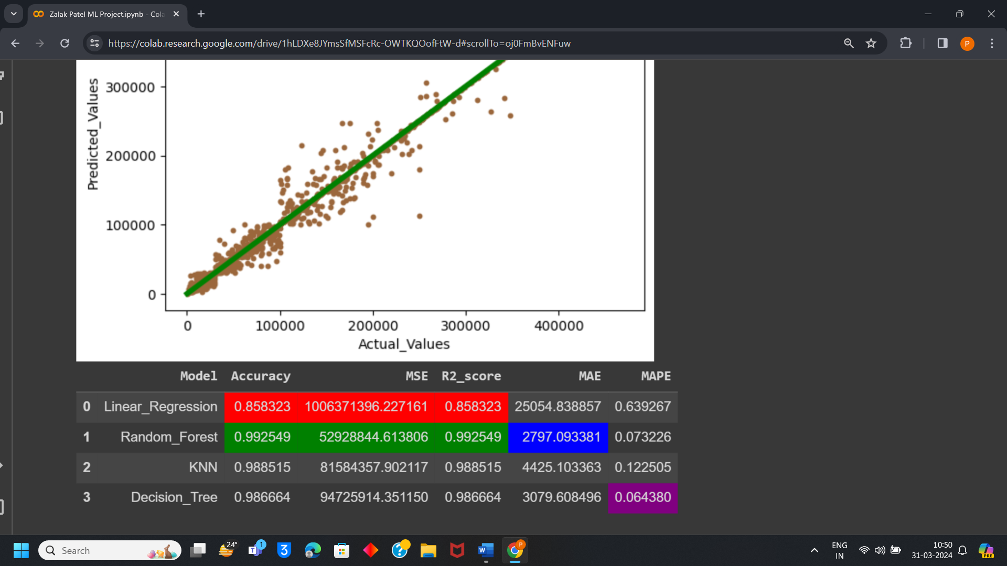
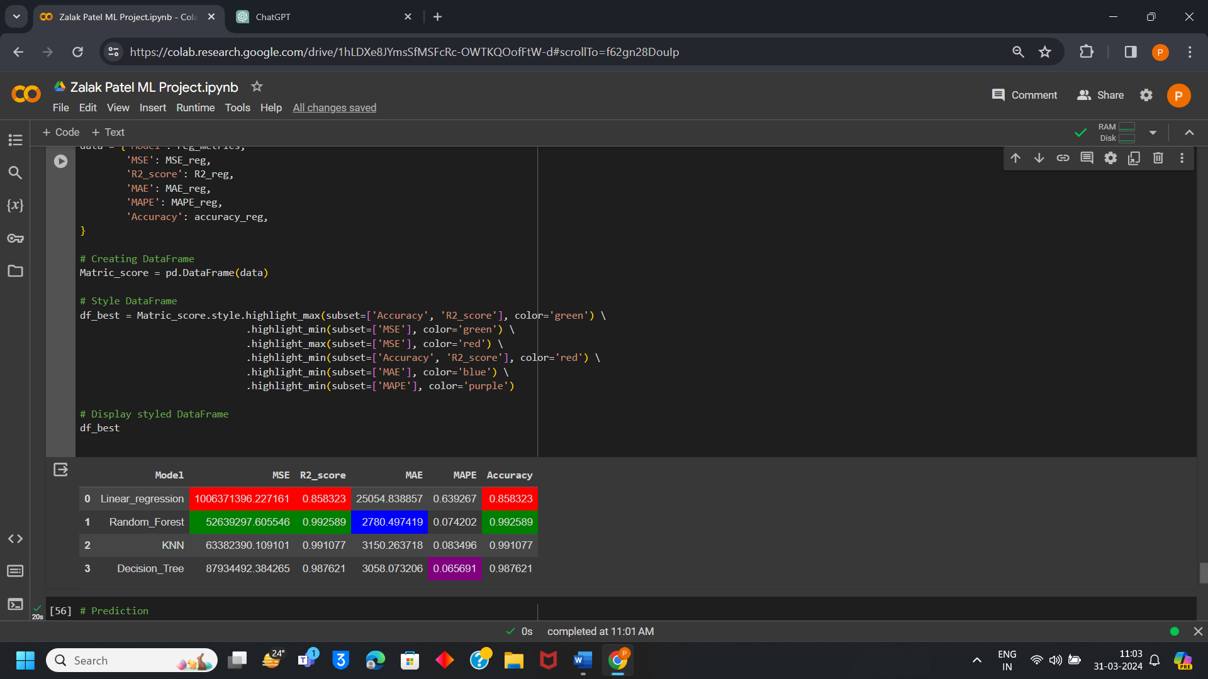
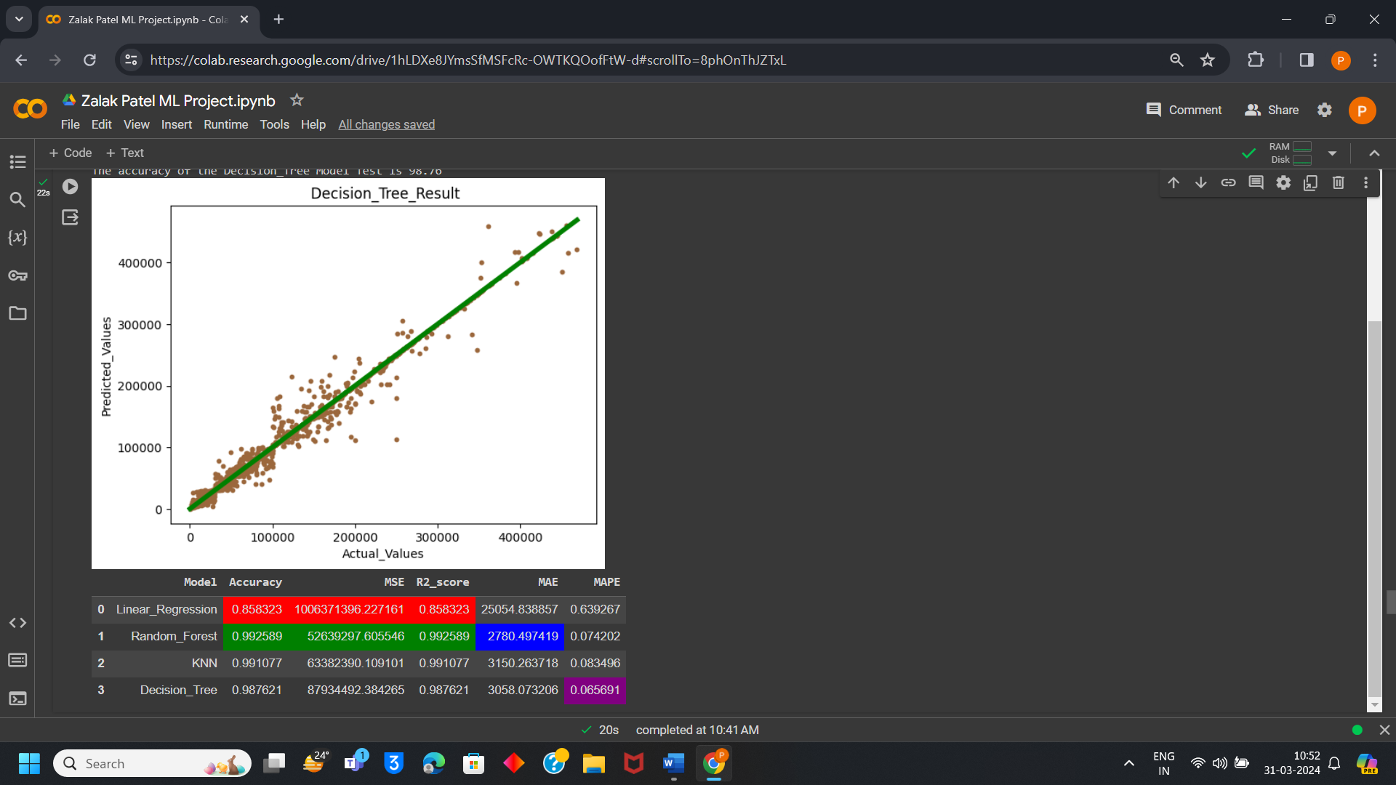
EVALUATION METRICS AFTER MODEL IMPLEMENTATION
COMPARISION TABLE
EVALUATION METRICS AFTER HYPERPARAMETER TUNING

Slide 16
CONCLUSION
From the above project of Crop Yield Prediction it can be seen that among all 4 algorithms such as Linear Regression, Random Forest, K Nearest Neighbor, Decision Tree the most accurate for this project on predicting crop yield is Random Forest Algorithm as its accuracy is around 99% which is the highest accuracy then all other algorithms.
K nearest Neighbour and Decision tree are also accurate that is around 99% and 98% but Random Forest is more Accurate then this two algorithms. Whereas Linear Regression is the lowest among all four in accuracy which is 85% so it can be considered least accurate model for crop yield prediction.
Hence, it is clearly visible that Random Forest is best fitted for Crop Yield Prediction and it can give accurate result for yield prediction on bases of factors such as rainfall, temperature, pesticides etc. So, Random Forest is used for prediction as it gives accuracy and farmers can be benefitted.
GOOGLE COLAB LINK:
https://colab.research.google.com/drive/1hLDXe8JYmsSfMSFcRc-OWTKQOofFtW-d#scrollTo=MyzWYvCfL7I8

Slide 17
THANK YOU

